Slide 1

Project Title -Seasonal Agriculture Performance Analysis
[Student Name-ABHISHEK VERMA]
[College Name-Dr. Ambedkar Institute of Technology for Divyangjan (A.I.T.D.) ]
AICTE STU ID :STU6a172d2d6d7a81779903789

Slide 2

PROBLEM STATEMENT .
Agricultural activities are influenced by seasonal variations in environmental conditions, farming practices, resource availability and market conditions. As a result, agricultural performance may differ from one season to another. However, raw agricultural data does not clearly explain how agricultural performance changes across seasons or what patterns can be observed in different seasonal conditions. The problem is to analyze the given agricultural dataset and investigate seasonal differences in agricultural performance by identifying meaningful patterns, trends, relationships and variations within the available data

Slide 3
Project Description This project analyses seasonal agricultural performance across Kharif, Rabi, and Zaid seasons using a 4,000-record farm dataset covering environmental conditions, farming inputs, and economic outcomes. It applies data cleaning, statistical testing, and visualization to uncover seasonal patterns and relationships, delivering data-driven recommendations for better agricultural planning.

Slide 4

WHO ARE THE END USERS?
Farmers, agricultural planners/advisors,
government Agri-departments, Agri-tech companies and researchers

Slide 5

Technology Used
Category | Tools/Libraries
Language | Python
Data handling | Pandas, NumPy
Visualization | Matplotlib, Seaborn
Statistical analysis | SciPy (ANOVA, Chi-square tests)
Environment | Jupyter Notebook (Google Colab)
Version control | Git, GitHub

Slide 6
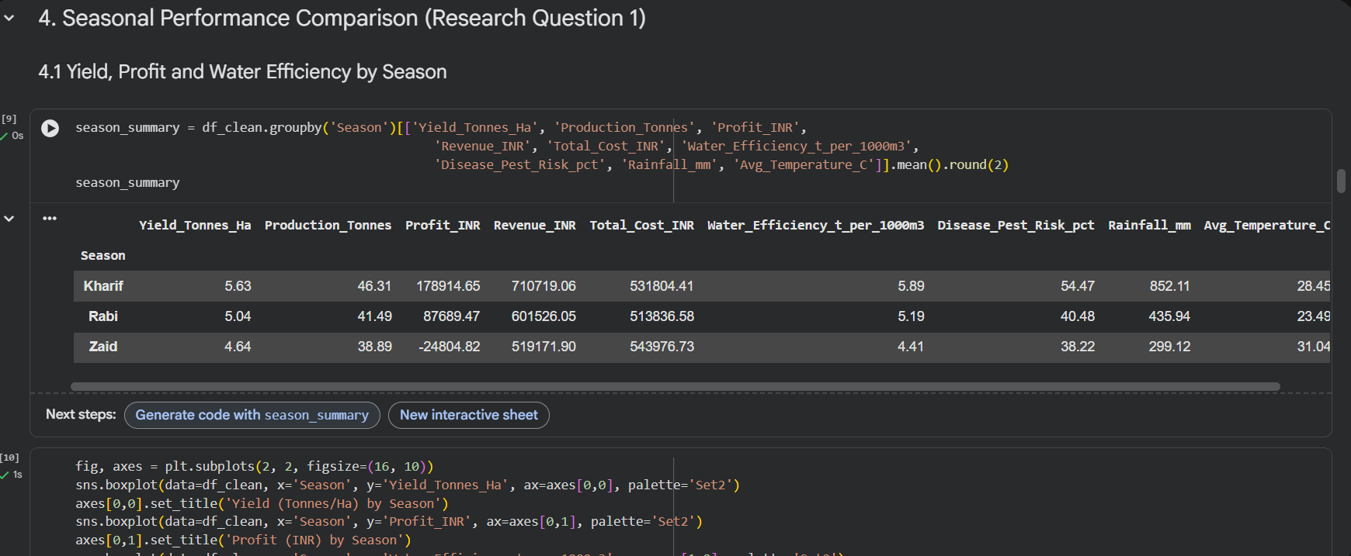
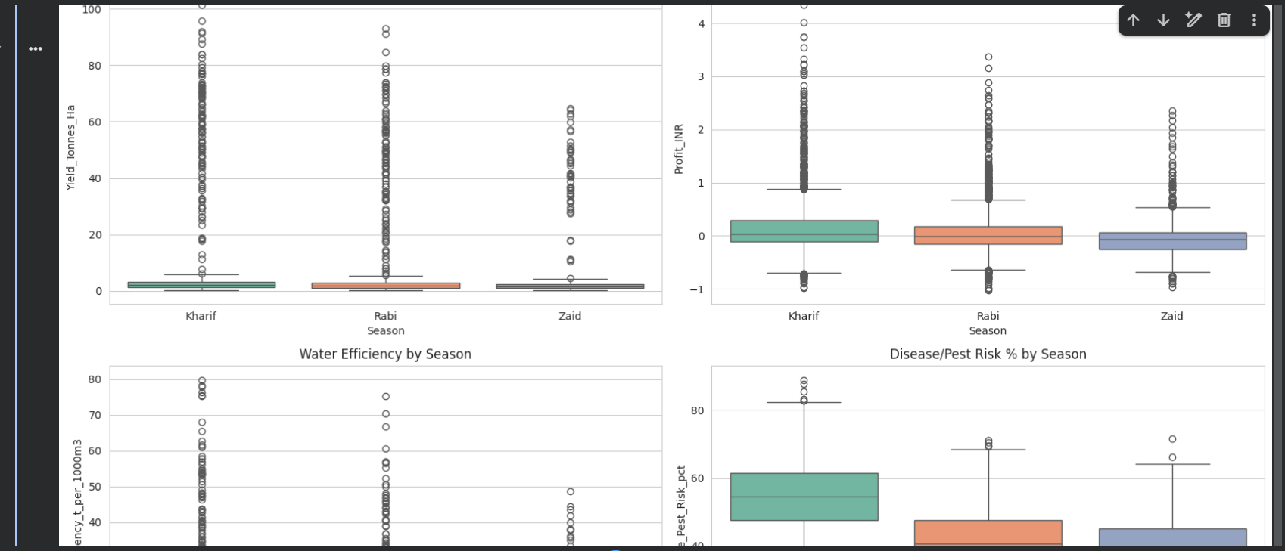
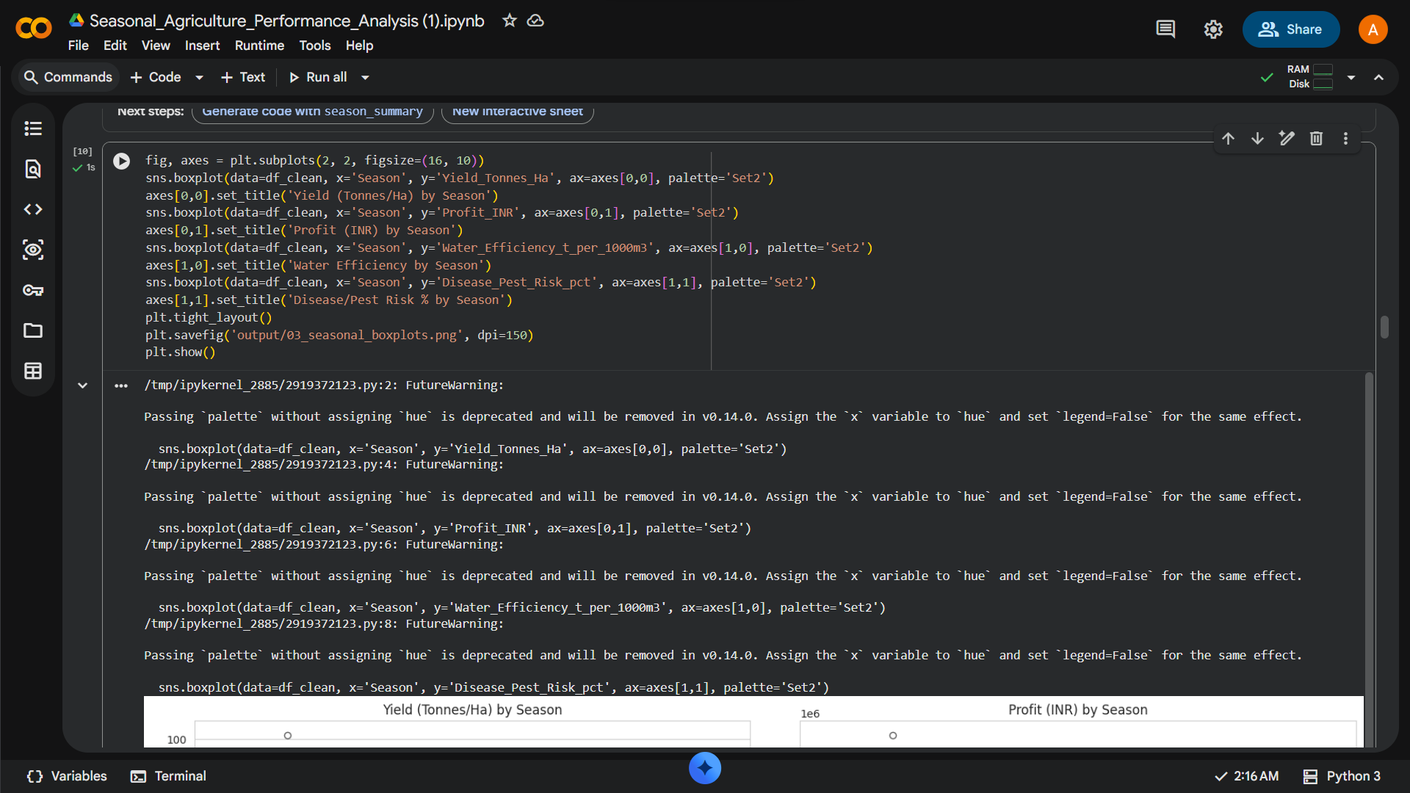
RESULTS
[Screen shots of code ]

Slide 7
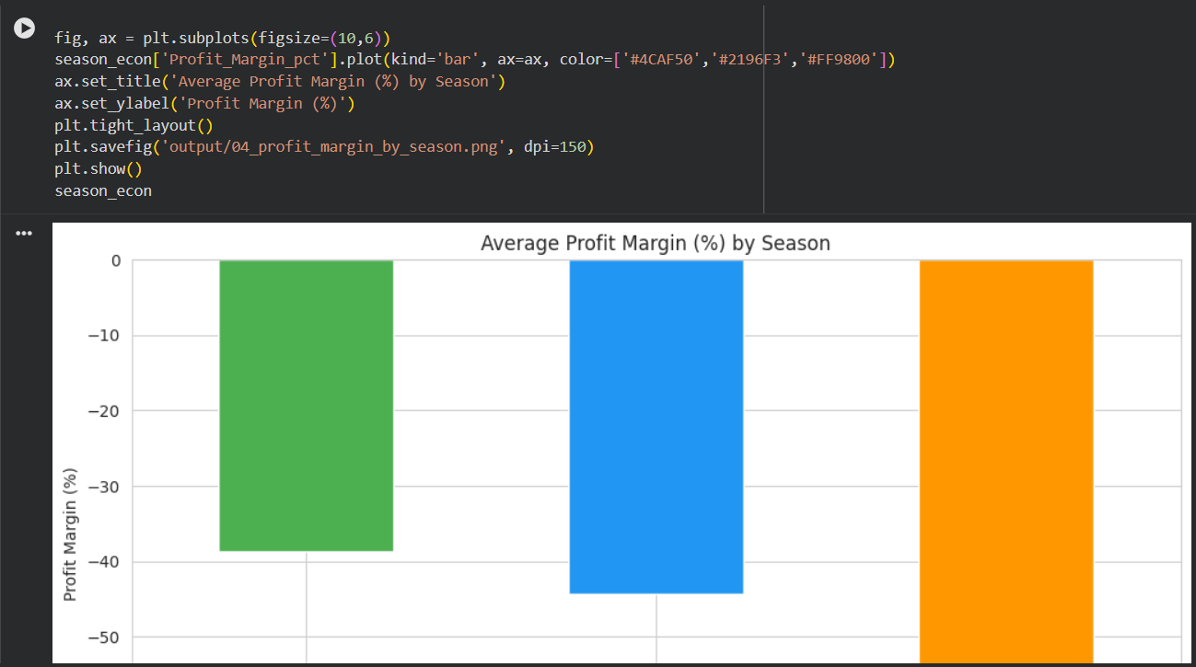
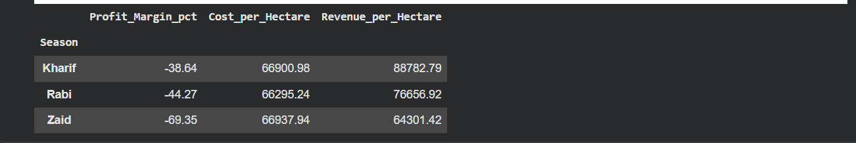
RESULTS
[screen shots of code ]

Slide 8
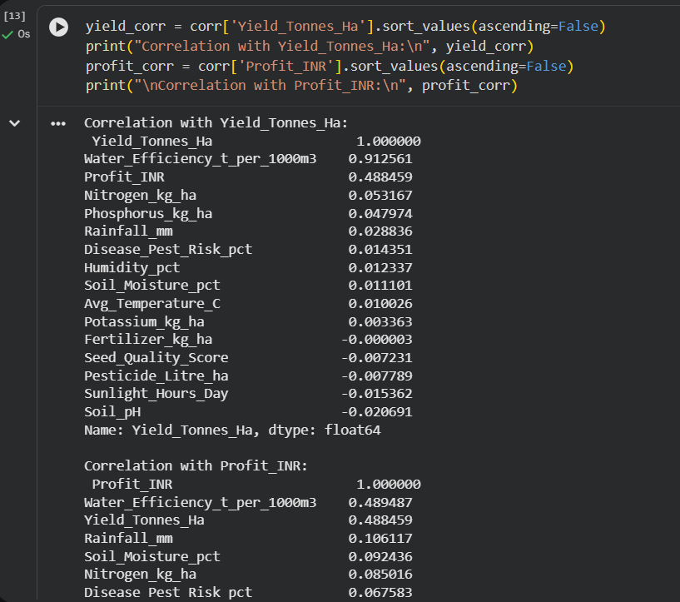
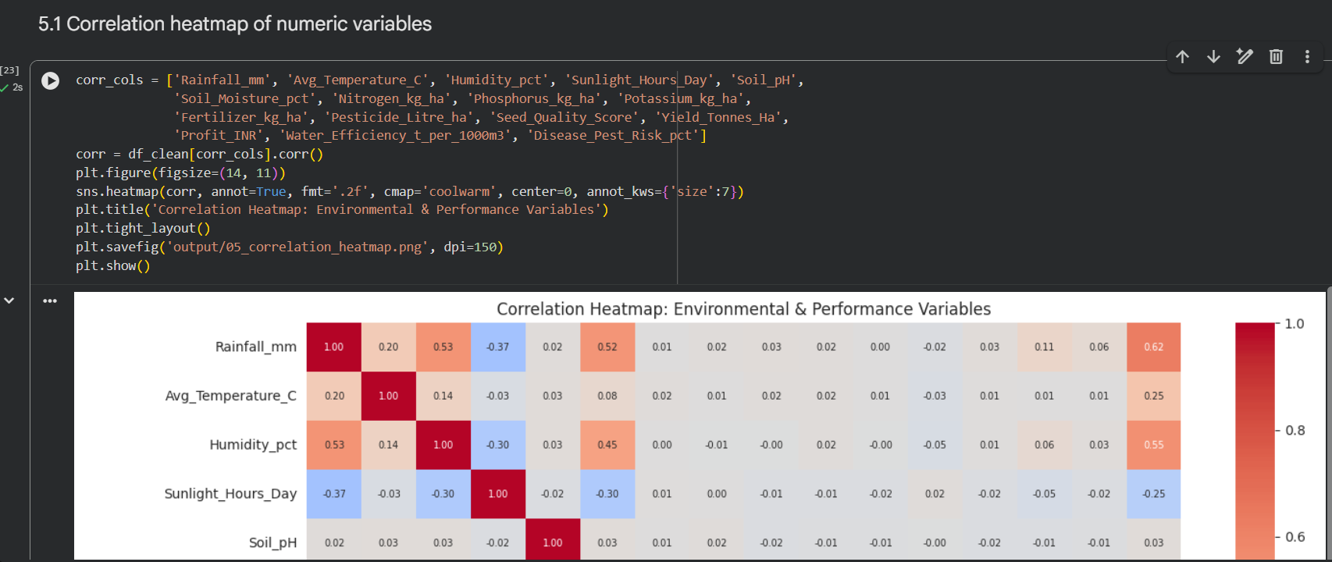
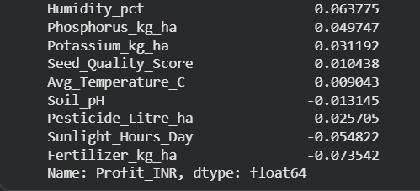
RESULTS
[Screen shots of code ]

Slide 9
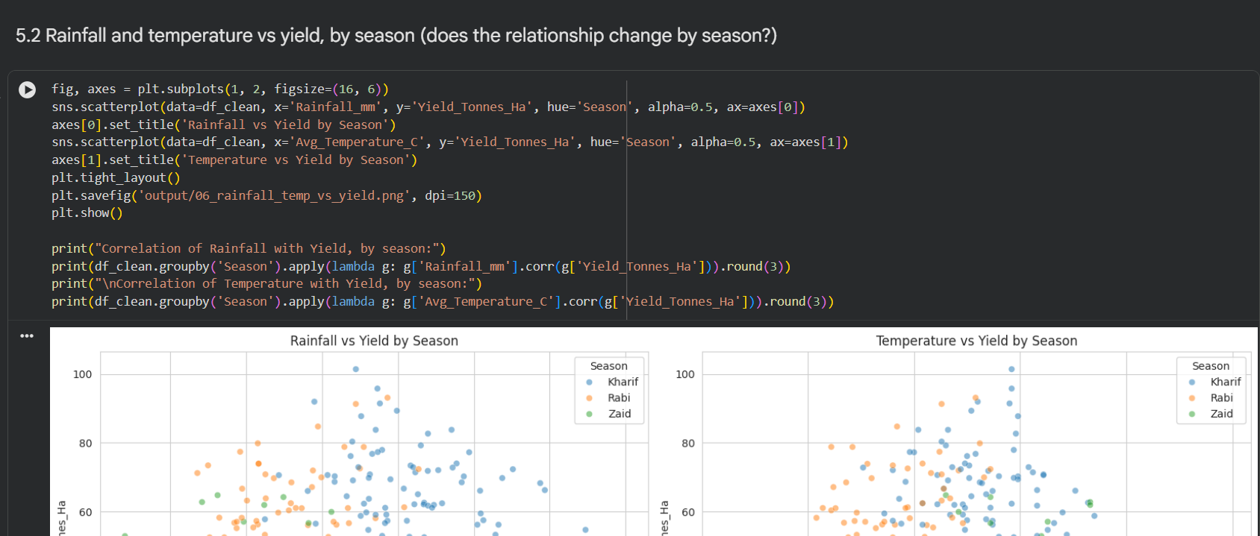
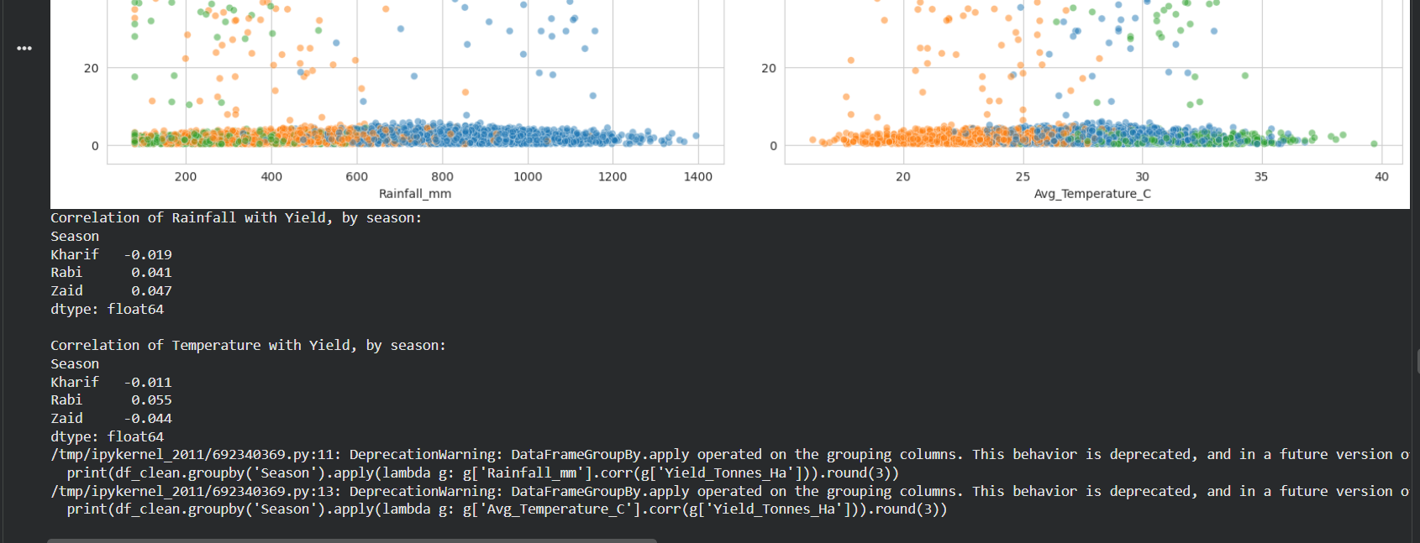
RESULTS
[Add screen shots of your code ]

Slide 10
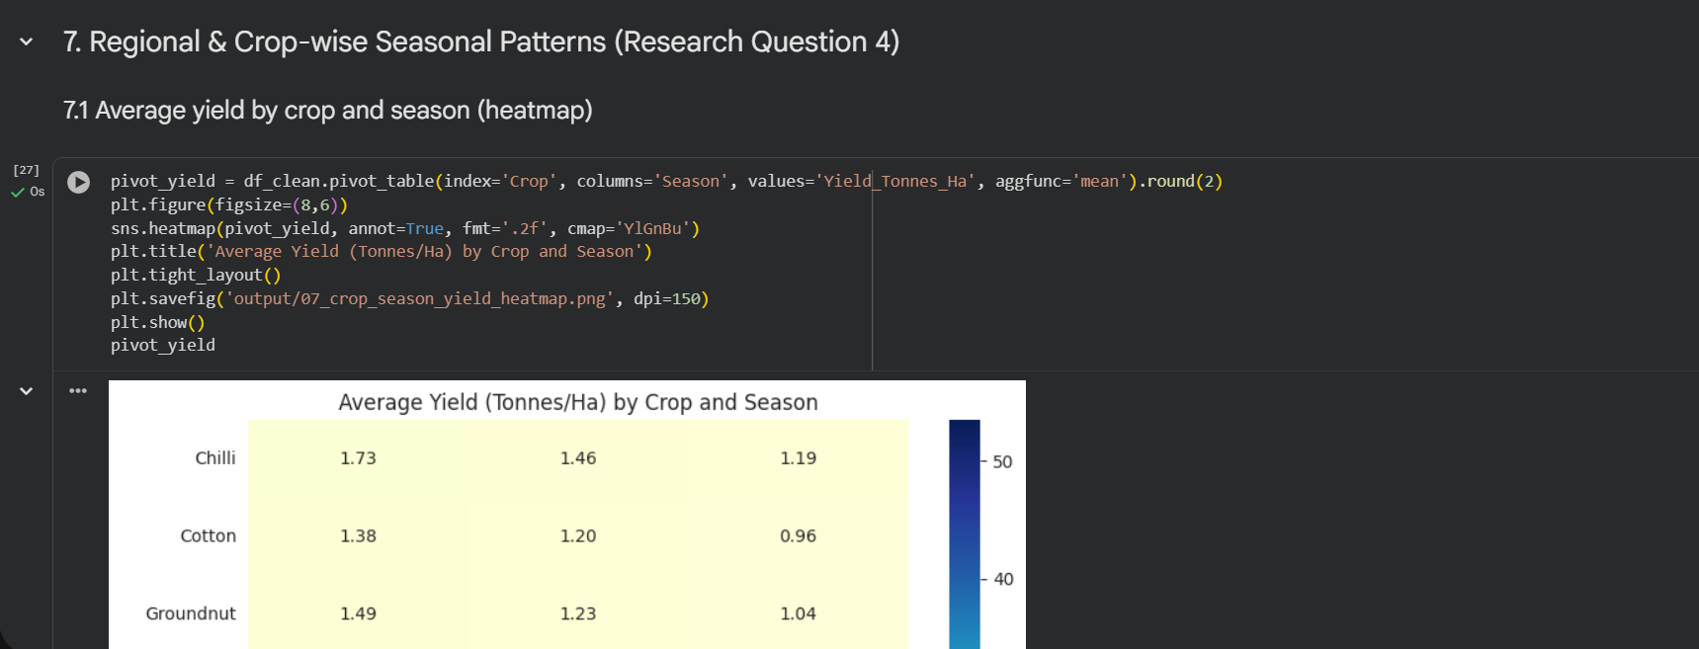
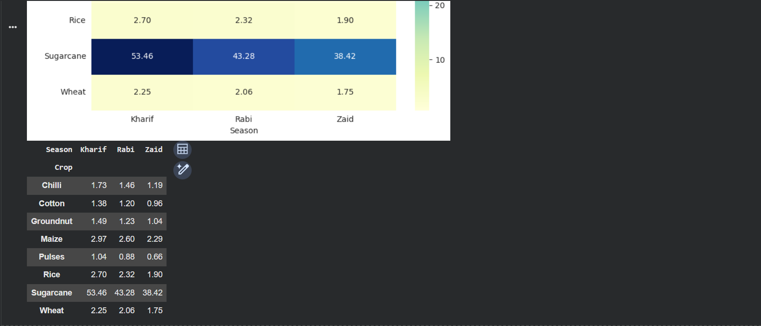
RESULTS
[Add screen shots of your code ]

Slide 11
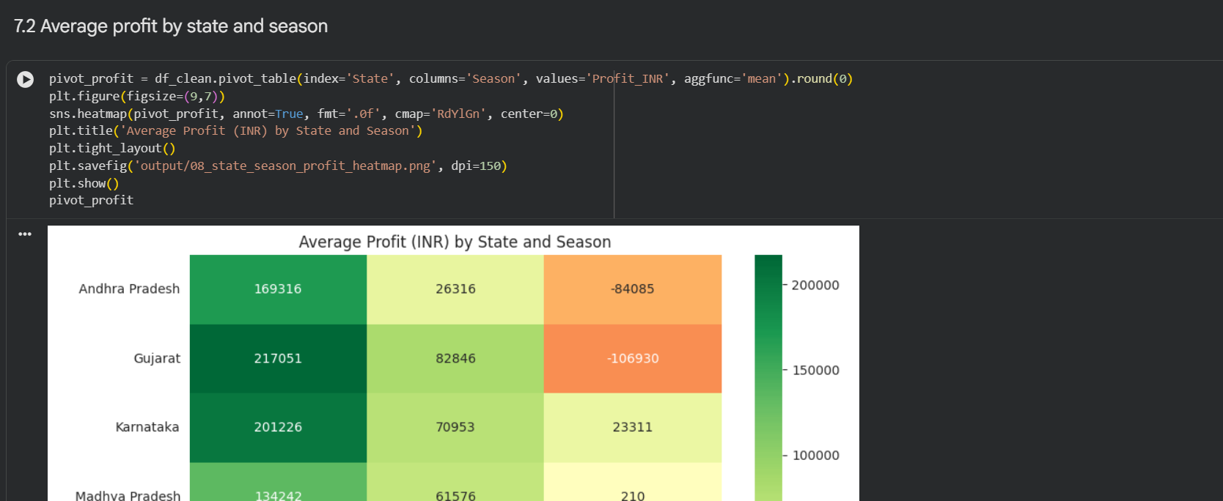
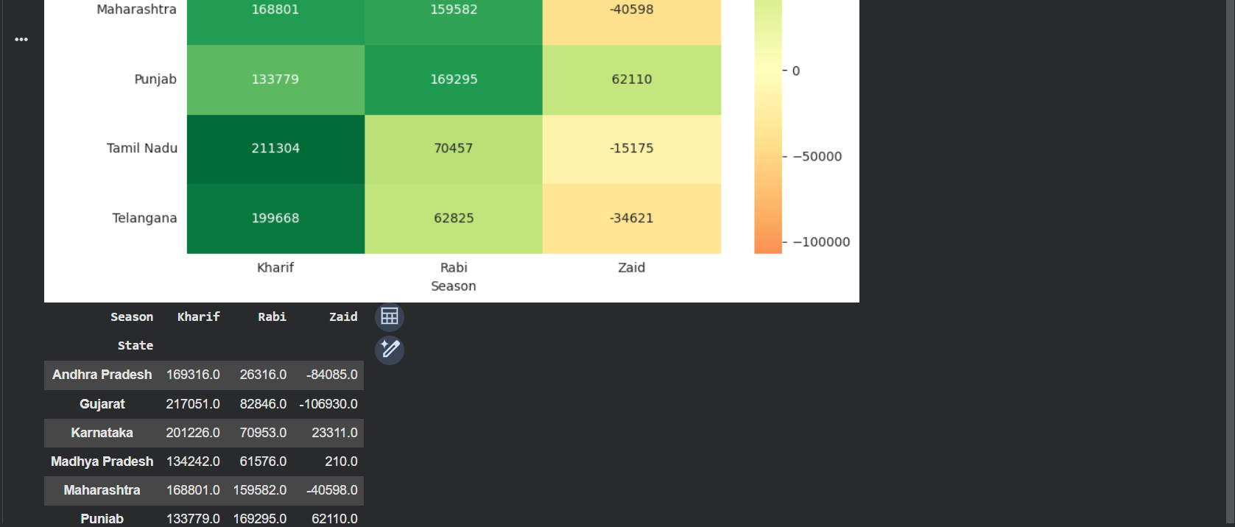
RESULTS

Slide 12
RESULTS
[Add screen shots of your code ]

Slide 13
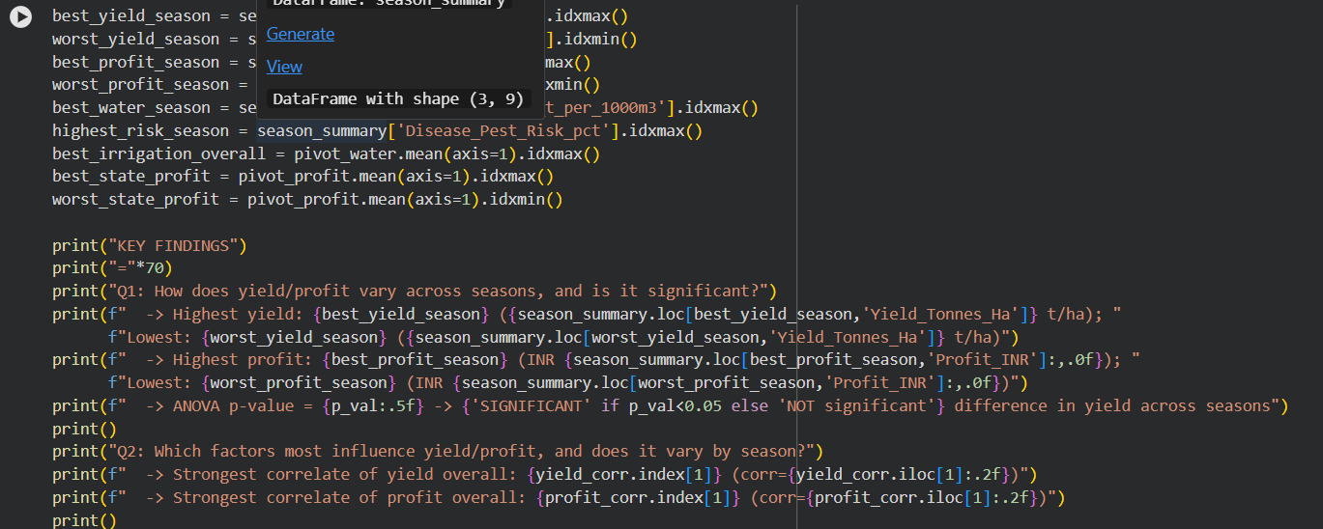
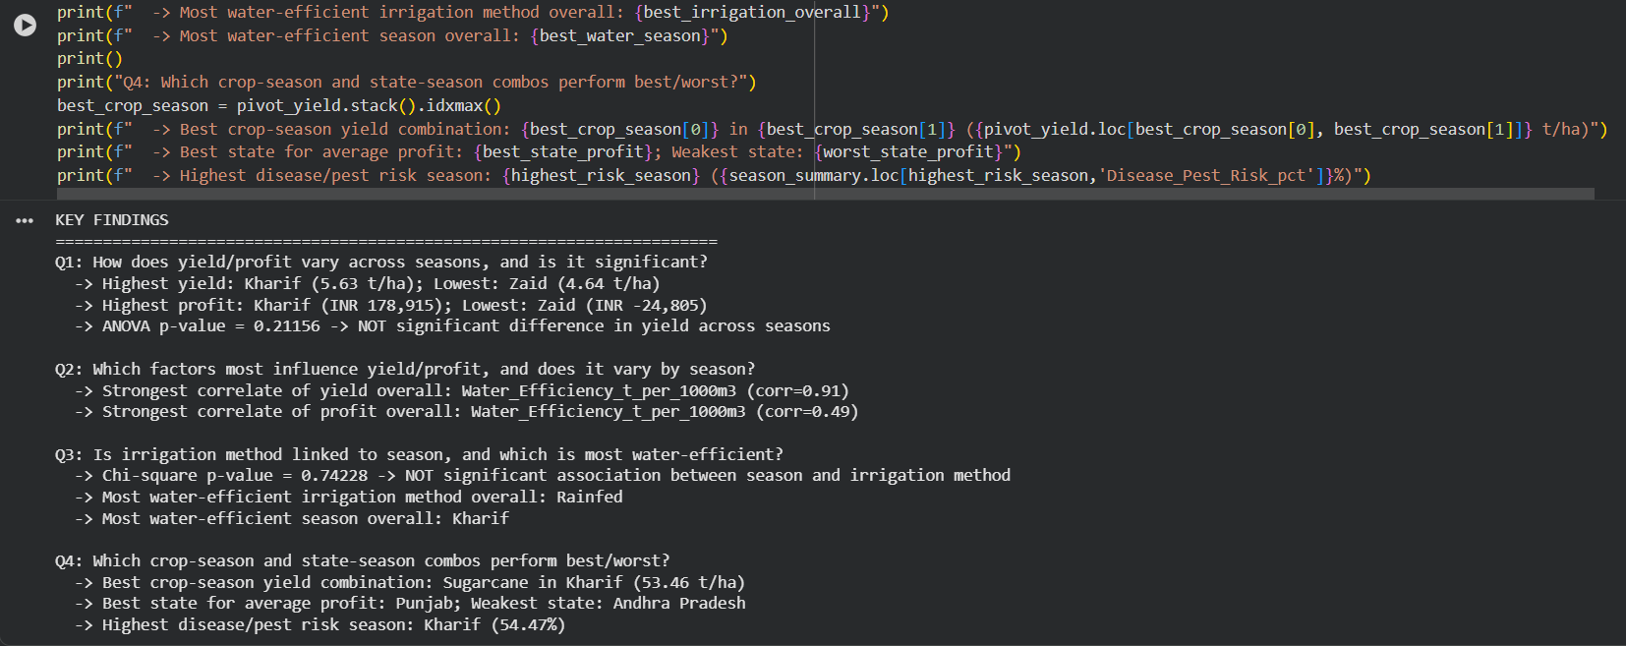
RESULTS
[Add screen shots of your code ]

Slide 14
Future scope
Extend analysis with multi-year data and real-time weather forecasts to build predictive seasonal planning models

Slide 15
GitHub Link
https://github.com/avcoder0223/Seasonal-Agriculture-Performance-Analysis.git

Slide 16
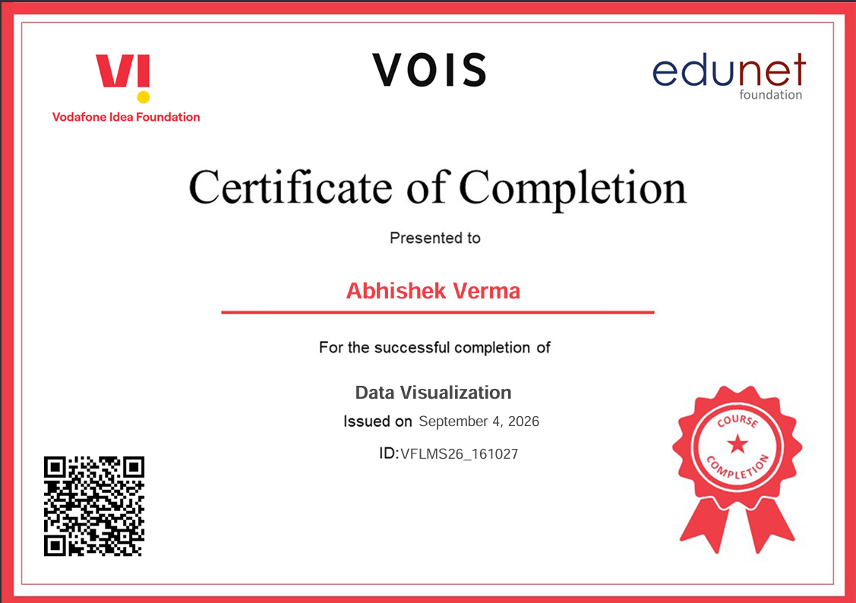
VOIS Course completion certificate - Course name- Data Visualization

Slide 17
Thank you
.
.

